Slide 1
Pavement Defects Detection Based on Yolov5 and Generative Adversarial Network
DSPS Conference 2022
Group Members:
Tianjie Zhang,
Steven Kim,
Amanda Mullins,
Yang Lu
Mar. 23, 2022
Notes:
Hello everyone, and thank you so much for having us at this year’s 2022 DSPS Competition. We are with Boise State University, this is Steven Kim, TJ Zhang, and Amanda Mullins. We are here to present our findings from our ‘Pavement Defects Detection Based on Yolov5 and Generative Adversarial Network’.

Slide 2
Overview
Introduction
Data
Methodology
Results
Conclusion
Notes:
The overview of our presentation can be seen here. We will discuss a brief background of pavement distress detection, the data of this project, the methodology, results, then conclude with a brief summary.

Slide 3
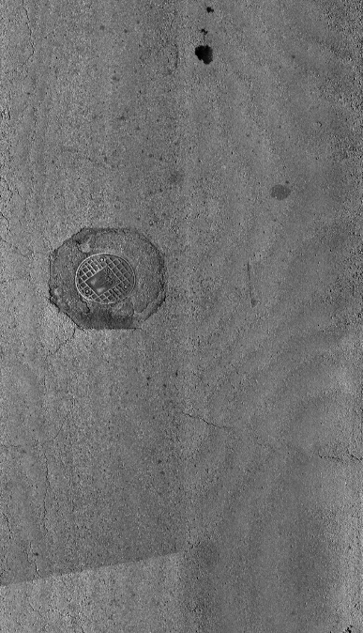
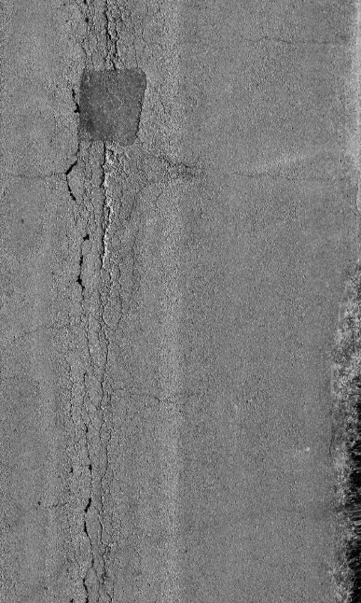
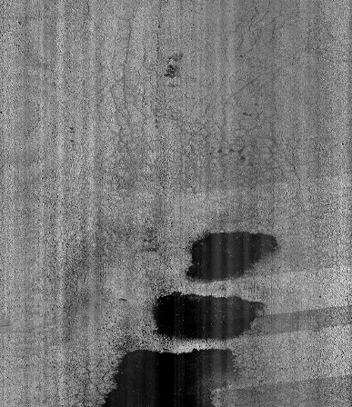
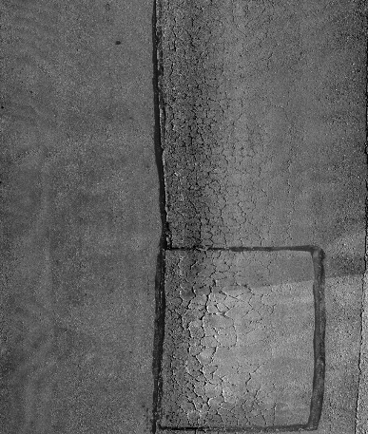

Introduction
Pavement distresses:
Cracking
alligator
transverse
block
longitudinal
Patching
Sealing
Manholes
Pavement Distress
From: DSPS22
Intelligent pavement detection
and identification becomes a significant task.
Traditional inspection: Time-consuming, Labor-intensive, Dangerous, Affect Traffic
Notes:
*Pavement Distresses*
There are several different pavement distresses, such as various cracks,patching, ceiling ect., that occur over the course of a pavement’s service life and can negatively impact the performance and longevity of the structure lifespan. These distresses can occur as a result of loading, environmental conditions, chemicals, and materials used.
*Prevention and identification*
The traditional method to get the number and distribution of defects is counting manually by engineers. However, this method is time consuming, labor intensive and also sometimes dangerous, affecting the traffic.
A promising new field of interdisciplinary work with computer science being applied to the civil engineering industry, is intelligent pavement defect inspection and identification. If this method is implemented correctly, it could be utilized to identify pavement defects, the severity of the distress, and implement repairs; all through nondestructive methods.

Slide 4

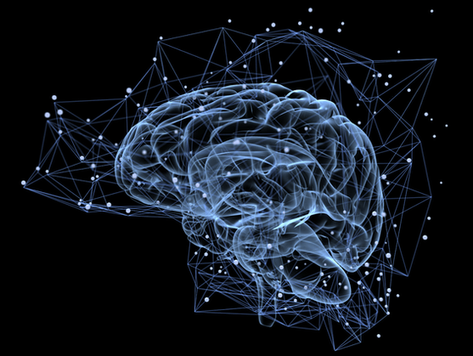
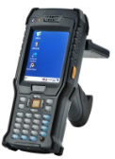
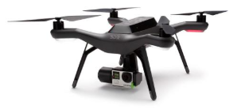

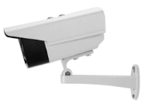
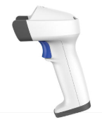
Introduction
Machine Learning Convolutional methods deep Learning
K-Means RF SVM Threshold Edge Yolo CNN GAN
Accurate
Pavement Distress Detection
Robust
Auto
Data
Notes:
Improving the accuracy and efficiency of this process is currently a hot topic for civil engineering research. The main methods to detect deterioration in roads can be divided into three categories.
The first is conventional methods, like threshold segmentation, edge detection and minimal path selection algorithms are computationally efficient, but perform poorly in terms of robustness, as it easily fails when it encounters illumination changes or irregular shaped defects.
The second is Machine learning methods, such as support vector machines and random forest can achieve better accuracy than conventional methods when facing new situations during road inspection. However, feature engineering, which heavily depends on the engineer's knowledge, may limit the overall performance.
The third is Deep learning methods. it is becoming one of the most advanced pixel-level target detection methods in road condition inspection. Many methods like CNN and YOLO have good applications in the transportation infrastructure management field. However, it requires a vast amount of pavement damage images to achieve accurate network training.

Slide 5
Data
From: Organizers of DSPS22 (Kansas city, Jefferson city, Columbia, Missouri)
Distress: 7 main distress types
Resolution: 2011×1014 pixels
Annotation: The second release data was annotated by our team members while the first release was annotated by Sponsor.
Limits:
1. The amount of training and validation data is small for a deep learning model.
2. The pavement distresses in test data is unbalanced.
Notes:
The data is from the organizers of DSPS22, and are collected from three cities, Kansas city, Jefferson city, Columbia in Missouri. It contains 7 main distress types we have mentioned in the introduction part, including 4 kinds of cracks, manhole, sealing and patching. And the data was released by the DSPS through three times.

Slide 6
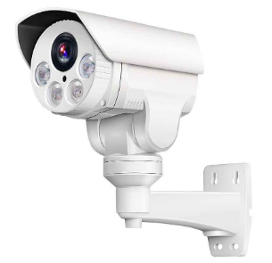
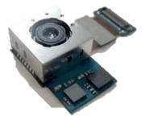

Data
Training
Validation
Testing
The first release
211
52
The second release
112
28
The third release
23
Notes:
The first release contains 211 images for training and 52 images for validation and all the images have been annotated by the sponsor. The second release contains 112 images for training and 28 images for tuning, but these images are not annotated. It was finally annotated by our team members. Thus, the logic in annotating these distresses are different. It may cause a decrease in test accuracy. However, I think it is necessary. As we know, there should be many engineers who will annotate the road images. Each person has his/her own understanding of the defects. We called it bias. So, by introducing the second release, the robust of the model would be improved a lot. The third release contains 23 images for testing.
However, as we can see, there are two limits on the provided dataset. The first is the amount. The total training dataset only contains 323 images which is quite small when using the deep learning model. the other limit is test data. The distresses in test data is not evenly distributed. It will cause an unbalanced problem. For example, manhole is the main distress in the test data. That means if I change the model’s preference to manhole. We will finally got a good model for this task although it may not fit well for other upcoming images.

Slide 7
Methodology
Pavement images
Preprocess
Training
Yolov5
Testing
GAN
Annotation
Validation
Organizer
Team
The overall procedure
The goal is to train the pavement distress detection model Yolov5, allowing it to learn the features of pavement distresses, and target the objects in top-down view images. Thus, in this work, what we contributes is in the amount of images
Notes:
Let me introduce our work. Firstly, our goal is to improve the accuracy of YOLOv5 when it targets the objects in the top-down view images. Because it is a data-centric competition, the model can not be changed. So The red part is our main contribute including image preprocessing, generative adversarial network and annotation.
First, the pavement images were processed by image preprocessing methods.
Then, the given images would be used as an input to the GAN (generative adversarial network), to produce fake images. The produced images and real images would be combined together as the input of the YOLOv5 model to detect the distress on the pavement surface.

Slide 8
Methodology
Purpose
Apply
YOLOv5
Pavement
Data-centric statistics
Data Cleaning
Annotation
Augmentation
Strategies
Image Preprocess
Increase Bias
Gaussian Filter
GAN
Histogram equalization
Annotate by different people
Normalization
Notes:
So Why we try to use these methods?
It is Based on the competition's data-centric statistics idea. The conference asked us mainly focus on the data cleaning, annotation and augmentation.
For the data cleaning part, due to the amount of images being quite low, we try to use the image preprocess method to denoise the images. Three methods including Gaussian Filter, Histogram equalization and Normalization were used in the work. For the annotation part, our solution is to increase the bias to improve the YOLOv5’s robustness. For the augmentation part, we introduce the generative adversarial network to increase the amount of the images as lack of image is always been a problem in deep learning models.

Slide 9
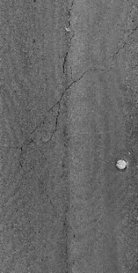
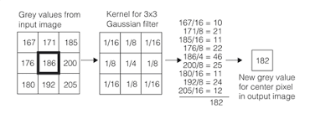
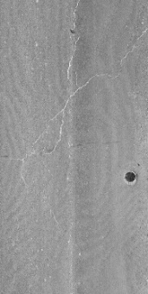
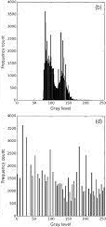
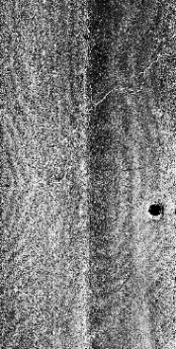

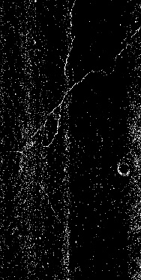
Methodology
Preprocess
Gaussian Filter
Mean subtract
Histogram equalization
Normalization: To make the pixel mean equal to zero
Notes:
For the image preprocess, as we know, Raw pavement images are negatively impacted by pulse interference that creates ‘noise’ for the model, which distracts it from the actual crack area on the surface.
In order to mitigate or ‘denoise’ this occurrence, a Gaussian filter is applied to the images. Gaussian filter is using a gaussian kernel to apply on each pixel and get a new value. Through this way, the image would be more smooth, and some noise would be removed.
In addition to this, histogram equalization is used to enhance the defects illustrated in the image to make it more recognizable to the model, As we can see from the image. this method usually increases the global contrast, especially the pavement image is represented by a narrow range of intensity values.
Finally, image normalization is used to the image, that is, make the whole image mean equals to zero. We calculate the mean of the all pixels in the image and then for each pixel, subtract the mean value. Using this method, the majority of the normal part would be removed and only the distresses would stay. Thus, this is a good way to remove the noise.

Slide 10
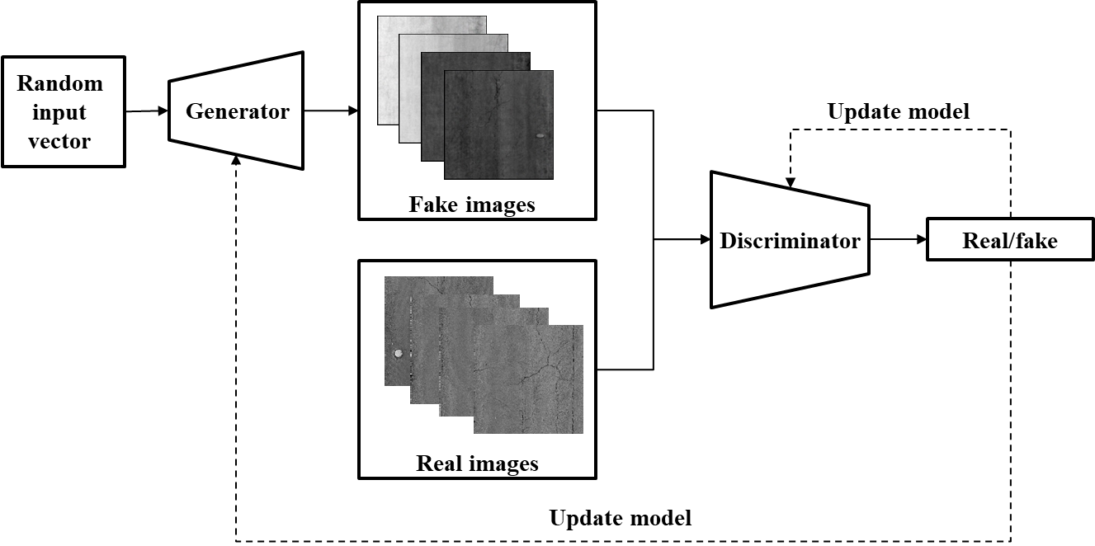
Generative adversarial network (GAN)
A class of ML frameworks
Contains two neural networks (G and D) contest with each other+ref
Notes:
Then for the generative adversarial network. First, what is GAN? It is a class of machine learning frameworks. It contains two neural networks, we called generator and discriminator. As we can see from its name, the generator is used to produce fake road images. And then the fake images and real images would mixed together and put in the discriminator. And discriminator is used to tell if the image is fake or real. AS you can imagine, it is a battle between the generator and discriminator. The generator would try his best to produce images as real as possible while the discriminator would try his best to discrete the fake and real images as accurate as possible. Then, finally, when it reaches some point, like the error is smaller than what we set. Finally , we can get the real-like images from the generator.

Slide 11
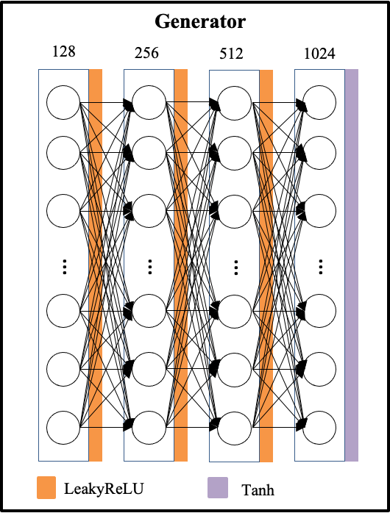
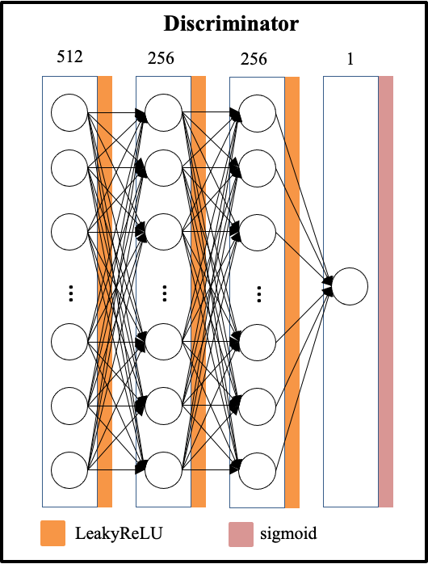
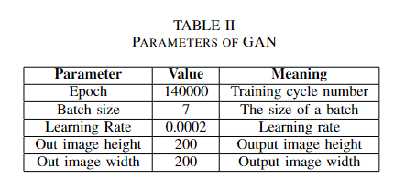
Methodology
Generator:
Deep Neural Network with three hidden layers.
Discriminator:
Deep leaning network with three hidden layers
Notes:
Both of the generator and discriminator are consisted of deep neural network. The generator has three hidden layers and the node is 128, 256, 512 separately, between the hidden layer the activation function was leakyRelu while at the end of the network, the activation function is Tanh. For the discriminator, it has three hidden layers also, the node is 512,256,256, and the output is one node, as real or fake. And then the actual class of the image will be compared with the result from the discriminator. The comparison will be used to update the parameters in discriminator and generator.

Slide 12
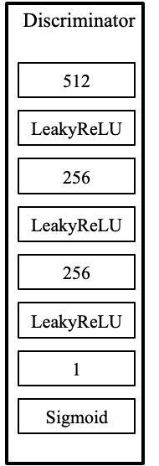
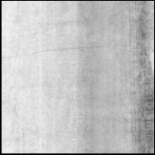
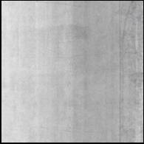

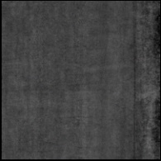
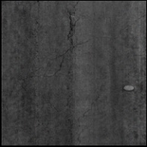
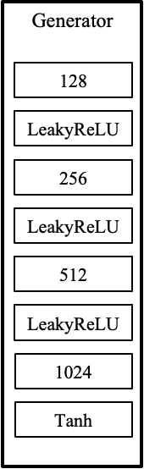
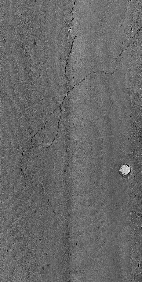
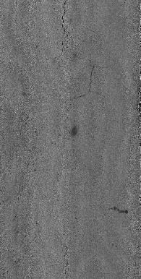
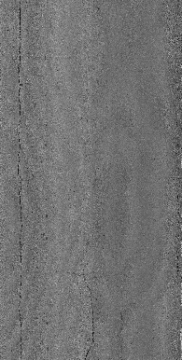
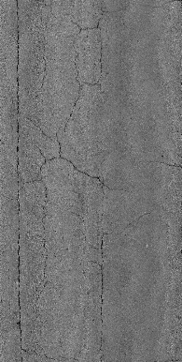
Methodology
Random input vector
Fake images
8 : 2
Update
model
Real images
Real/fake
Update model
Notes:
And then, in this work, 100 images were produced from the GAN to enlarge the amount of the dataset. Depends on the ratio of the given training and tuning data, we divided 100 images into 80 and 20. iteration increase, the fake image would be more real. The mechanic to improve the , error

Slide 13
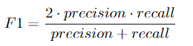
Methodology
DSPS Given Evaluation Metrics
The result is evaluated by F1 score. The F1 metric weights recall and precision equivalently, acting as a good retrieval algorithm, maximizing both precision and recall simultaneously.
Notes:
The yolov5’ result is evaluated by F1 score. The F1 metric weights recall and precision equivalently, acting as a good retrieval algorithm, maximizing both precision and recall simultaneously. Given

Slide 14


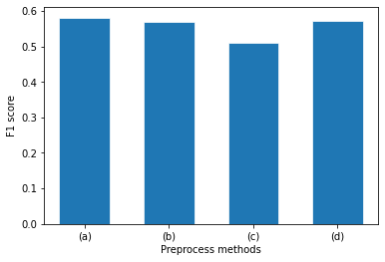
Results
Preprocess
The F1 score decreases after applying the preprocess methods
Image preprocessing may not be considered
(a)
(b)
(c)
(d)
Raw image: 0.581
Gaussian Filter: 0.573
Histogram equalization: 0.510
Normalization: To make the pixel mean equal to zero: 0.580
Notes:
To analyze why accuracy decreased, the tradeoffs from the preprocessing methods negatively affected our dataset. The Gaussian filter narrows down the boundaries between defects and background, thus reducing the accuracy. The histogram equalization sharpens the contrast; however, the feature of the non-defect area would widen, impacting the accuracy of the model. Subtracting the average value in the pavement image removes the background and noise, along with some useful features from the distress. Thus, image preprocessing in this task may not be considered a wise decision. To improve the model's F1 score, increasing the size of the data set becomes the most optimal choice.

Slide 15
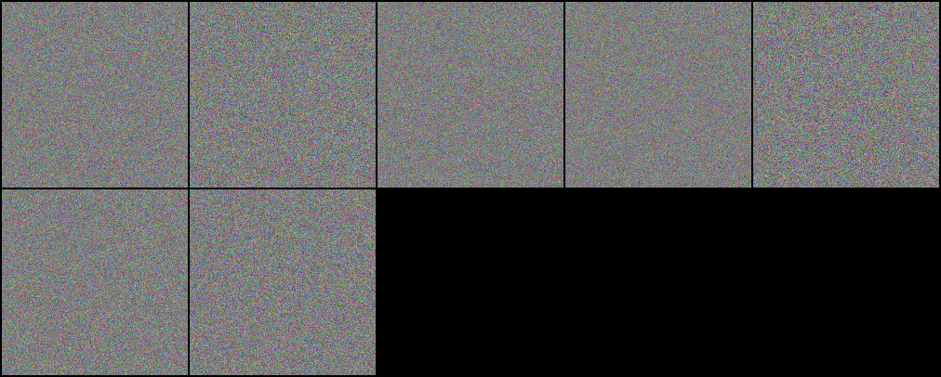
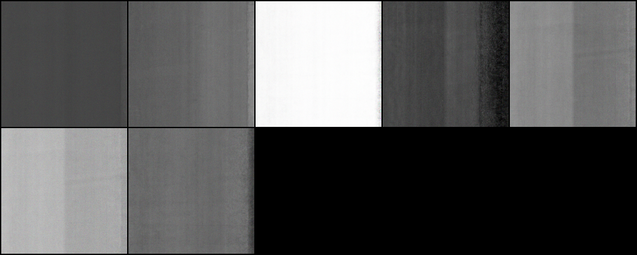
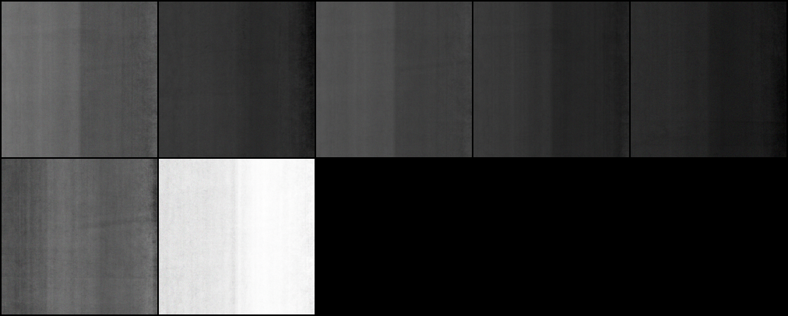
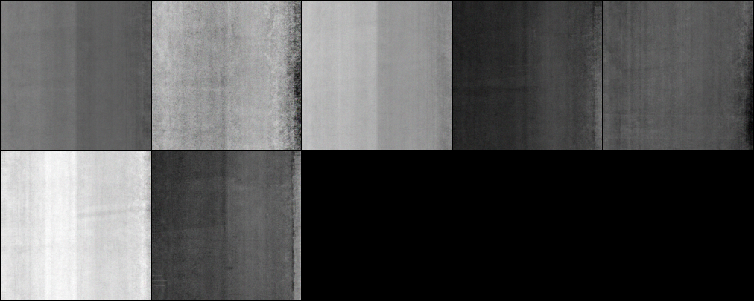
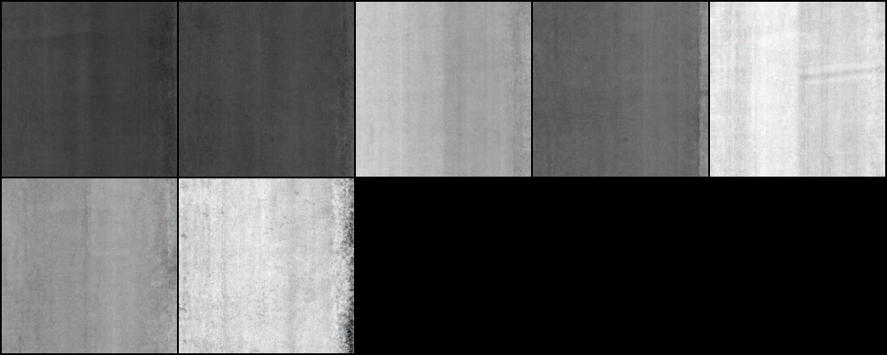
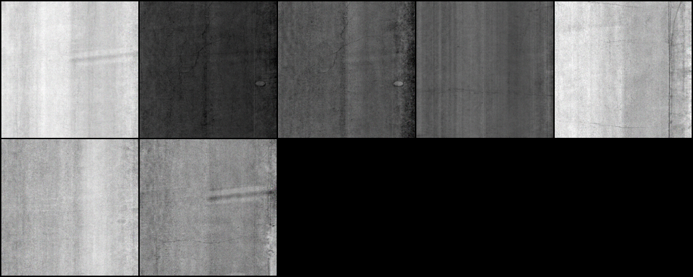
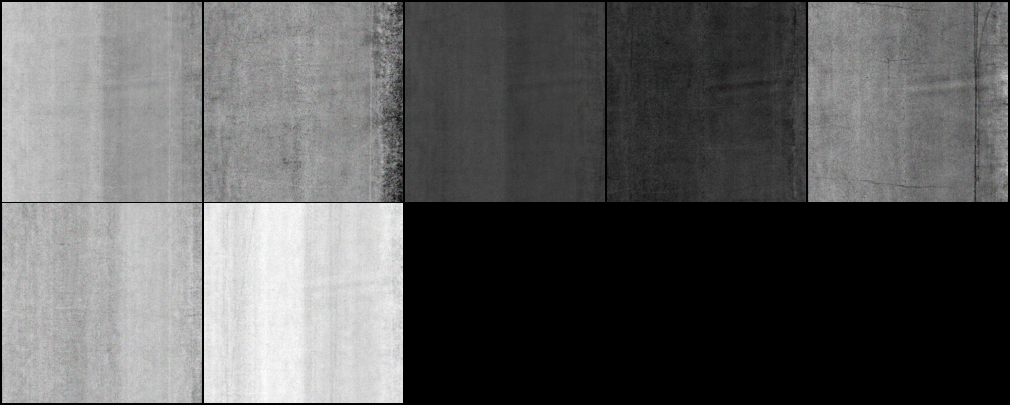
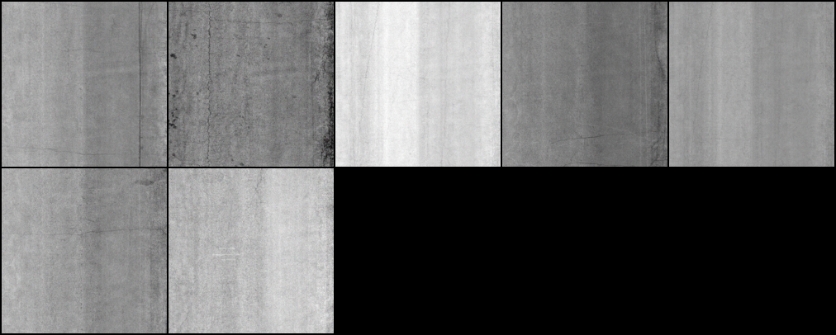
Results
0
20000
40000
60000
GAN
It take about ** hours to run the GAN and ** images were produced during this process. Finally, 100 images were chosen to use in the YOLOv5 model
80000
100000
120000
140000
Notes:
While in the 0 iteration of GAN, the fake image totally consisted of random noise. However, after 100000 epochs of training, the pavement surface image generated by the GAN model is quite similar to the real image, although the area around the distress is still slightly distorted. Thus, 100 fake images were selected after 100000 epochs as an another source of data.
Time limits, more iterations more accurate

Slide 16
Results
0 epoch
140000 epochs
Real image
GAN
0 epoch: The fake image was consisted of random noise.
After 100000: The fake image was similar to the real image.
Notes:
While in the 0 iteration of GAN, the fake image totally consisted of random noise. However, after 100000 epochs of training, the pavement surface image generated by the GAN model is quite similar to the real image, although the area around the distress is still slightly distorted. Thus, 100 fake images were selected after 100000 epochs as an another source of data.

Slide 17
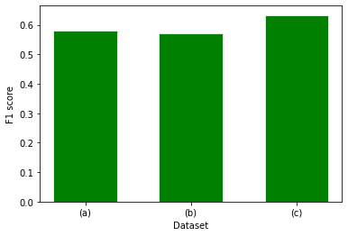


Performance Comparison using DSPS Test Dataset
Overall Process
The addition of fake images brought an increase in the F1 score of 0.633 compared to the raw data accuracy of 0.581.
The first release annotated by DSPS: 0.581
+the second release annotated by team members: 0.576
+the selected 100 fake images: 0.633
Annotation
GAN
Notes:
The Yolov5 model was tested by using different amount of images.
The addition of the second batch of images resulted in a decrease in the F1 score. The first batch and the testing data were annotated by sponsors of DSPS22, who might have diverse standards when it comes to annotating images. Thus, the outcome would be affected due to their definition of distress, which explains the small drop in the F1 score. Nevertheless, self-annotated images are necessary to the training and validation data, since it is considered as a tradeoff between the accuracy and the model's robustness. The addition of fake images brought an increase in the F1 score of 0.633. The improvement is considered significant, compared to the raw data accuracy of 0.581.

Slide 18
Conclusion
1. Image preprocessing methods such as histogram equalization, Gaussian filter and image normalization decrease the F1 score of the test result and are not considered in the overall process.
2. GAN can produce fake images to enlarge the amount of train data. Using GAN to generate more close-to-real pavement images is a cost - effective method.
3. In the overall procedure, based on the YOLOv5 object detection model, the GAN gains its importance in image augmentation and promotes a better result in the pavement distress inspection.

Slide 19
Future
1. The neural network of the generator and discriminator is a linear neural network. A convolutional neural network (CNN) would be more suitable for images generating.
2.The more pictures, the better results. This is because deep neural network depends a lot on the quality and quantity of images.
Notes:
Convergence quick

Slide 20
Thank You
Team:
Tianjie Zhang,
Steven Kim,
Amanda Mullins,
Yang Lu
Boise State University
Email: tjzhang@u.boisestate.edu

